Slide 1
CENG 477 Introduction to Computer Graphics
Shadows in Forward Rendering

Slide 2
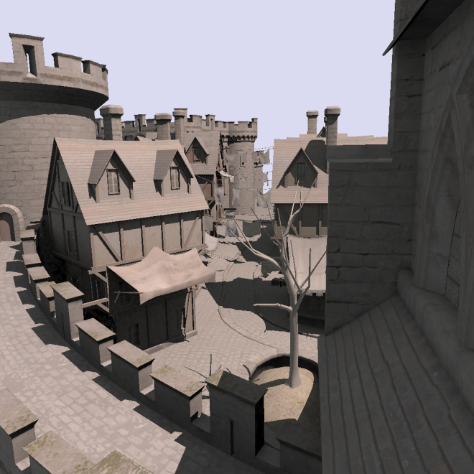
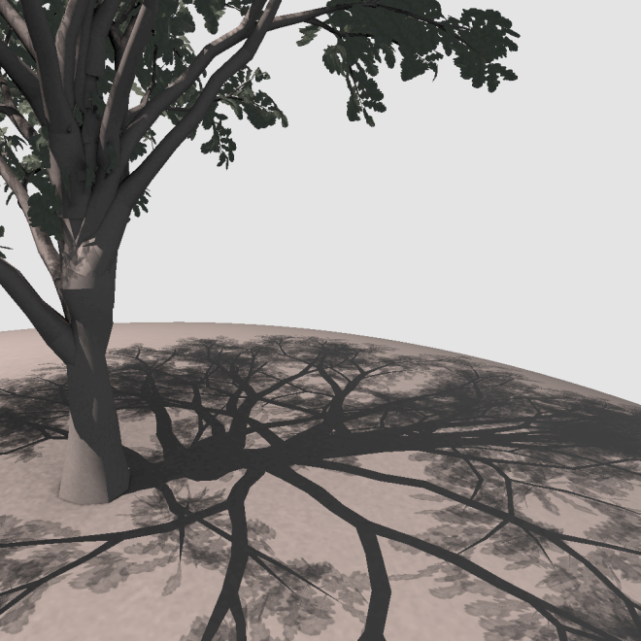
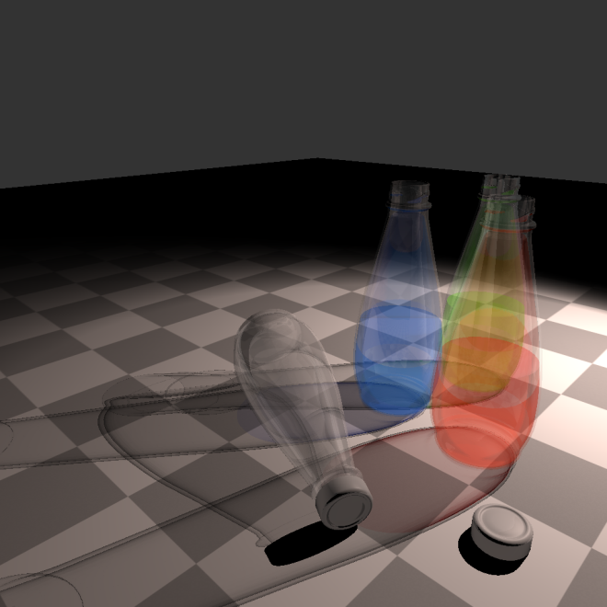
Shadows
Shadows are an important element of visual realism
From Sintorn et al. – Siggraph Asia 2012

Slide 3
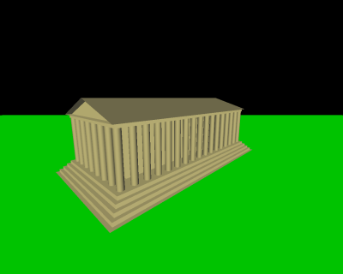
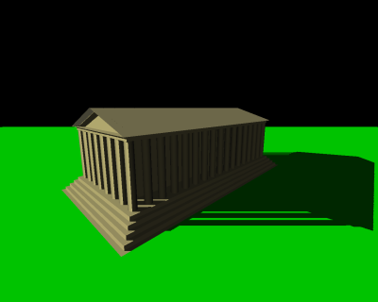
Shadows
Shadows give important cues about light positions
From wikipedia.com

Slide 4
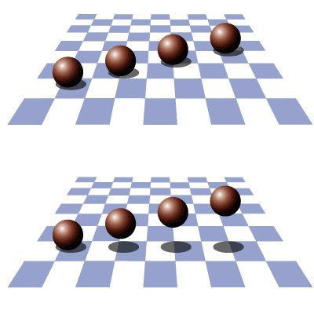
Shadows
Shadows also give cues about object positions

Slide 5
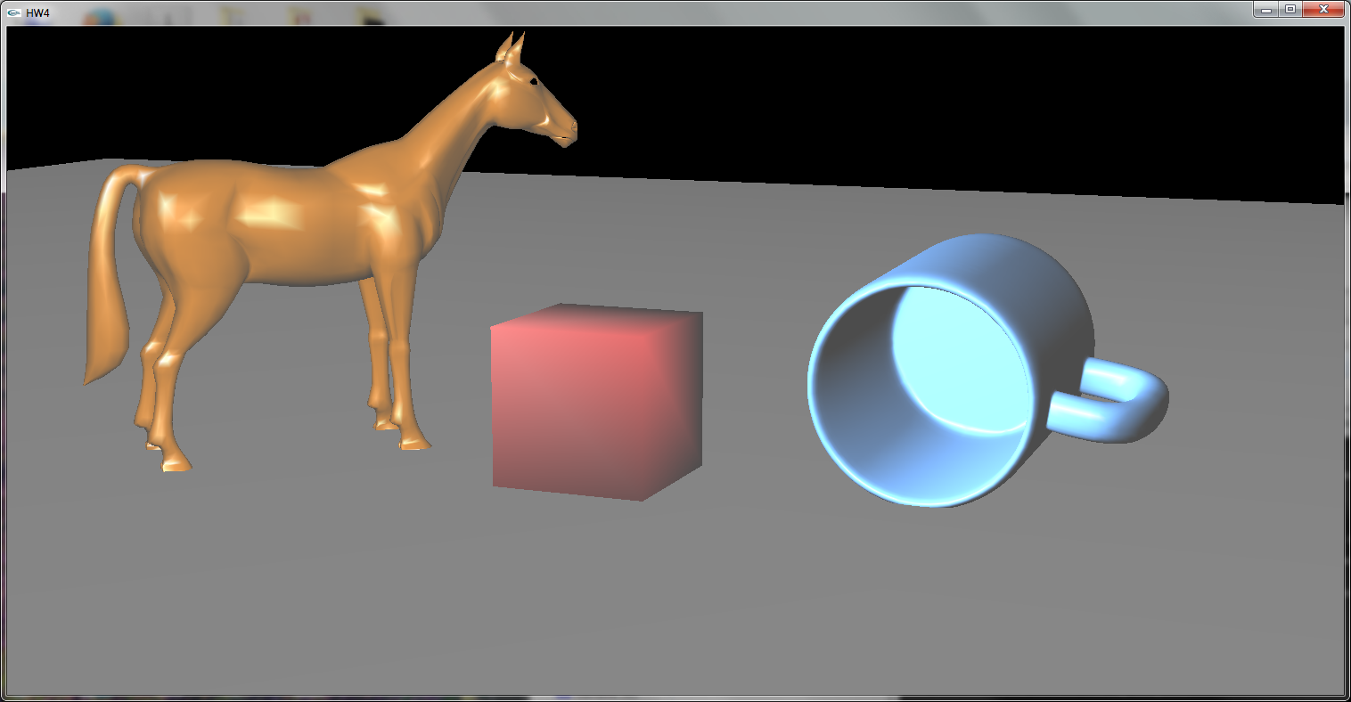
Shadows in OpenGL
OpenGL does not have built-in support for shadows

Slide 6
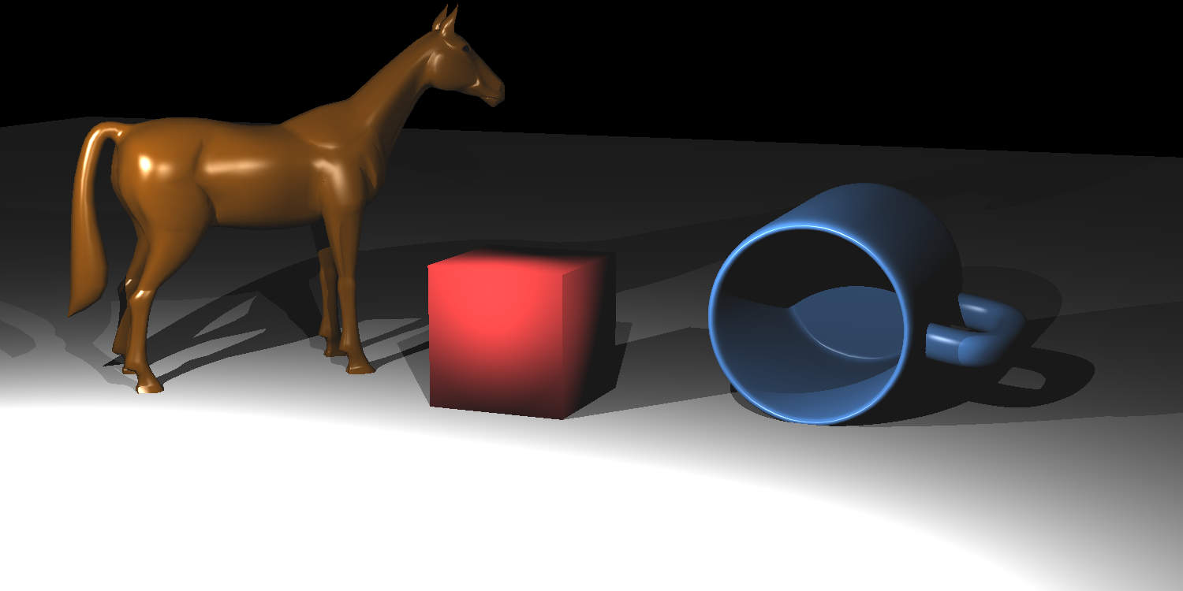
Shadows in OpenGL
Compare this to a ray traced image:

Slide 7
Shadows in OpenGL
OpenGL does not natively support generating shadows
That is, it does not have a function like glMakeShadow()!
But, several shadowing algorithms can easily be implemented using features of OpenGL
Stencil buffer
Depth buffer
Render to texture
…

Slide 8
Generating Shadows
Two algorithms that are commonly used are:
Shadow volumes (Crow, 1977)
Shadow mapping (Williams, 1978)
Both algorithm has advantages and disadvantages and many variants
Still an active research area:
Wang, J., Li, Z., Ali, S. G., Sheng, B., Li, P., Chi, X., ... & Mao, L. (2021, September). Dynamic Shadow Synthesis Using Silhouette Edge Optimization. In Computer Graphics International Conference (pp. 421-432). Cham: Springer International Publishing.
We’ll study the basic versions of these algorithms
CROW, F. C. 1977. Shadow algorithms for computer graphics. SIGGRAPH Comput. Graph. 11 (July), 242–248.
WILLIAMS, L. 1978. Casting curved shadows on curved surfaces. SIGGRAPH Comput. Graph. 12 (August), 270–274.

Slide 9
Shadow Volumes
The idea is to create a 3D shape that represents the shadow that is casted by an object
Unshadowed
object
Shadow volume
(extends to infinity)
Light
Shadow
caster
Shadowed
object

Slide 10
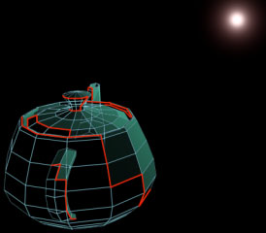
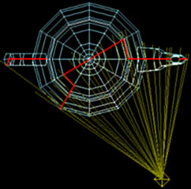
Shadow Volumes
A shadow volume can be created for any arbitrary object.
We need to determine the contour edges (silhouette-edges) of the object as seen from the light source
A contour edge has one adjacent polygon facing the light source and the other away from the light source
From John Tsiombikas

Slide 11
Contour Edges
A contour edge has one adjacent polygon facing the light source and the other away from the light source
We can use dot product to decide whether a face is toward or away from the light source
Face
normals
Light
Shadow
caster object

Slide 12
Contour Edges
// transform the light to the coordinate system of the object
LightPosition = Inverse(ObjectWorldMatrix) * LightPosition;
for (every polygon) {
IncidentLightDir = AveragePolyPosition - LightPosition;
// if the polygon faces away from the light source....
if (DotProduct(IncidentLightDir, PolygonNormal) >= 0.0) {
for (every edge of the polygon) {
if (the edge is already in the contour edge list) {
// then it can't be a contour edge since it is
// referenced by two triangles that are facing
// away from the light
remove the existing edge from the contour list;
} else {
add the edge to the contour list;
}
}
}
}
From John Tsiombikas

Slide 13
Extruding Contour Edges
Once the contours are found, we need to extrude them to create a large shadow volume
Light

Slide 14
Extruding Contour Edges
Extrusion amount should be large enough to cover all objects which can receive shadow from this light source
ExtrudeMagnitude = A_BIG_NUMBER;
for (every edge) {
ShadowQuad[i].vertex[0] = edge[i].vertex[0];
ShadowQuad[i].vertex[1] = edge[i].vertex[1];
ShadowQuad[i].vertex[2] = edge[i].vertex[1] + ExtrudeMagnitude *
(edge[i].vertex[1] - LightPosition);
ShadowQuad[i].vertex[3] = edge[i].vertex[0] + ExtrudeMagnitude *
(edge[i].vertex[0] - LightPosition);
}
From John Tsiombikas

Slide 15
Extruding Contour Edges
The shadow caster object’s contour vertices serve as the cap of the shadow volume.
The bottom can also be capped to obtain a closed volume.
Light

Slide 16
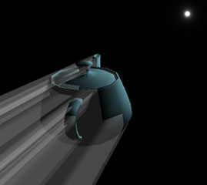
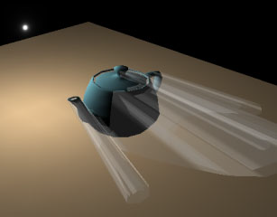
Extruding Contour Edges
This is how it looks like for a complex object
From John Tsiombikas

Slide 17
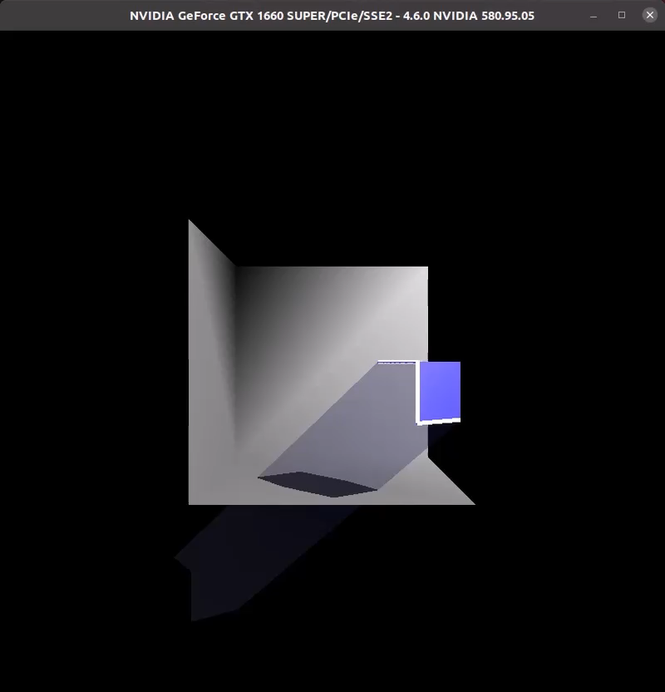
Example

Slide 18
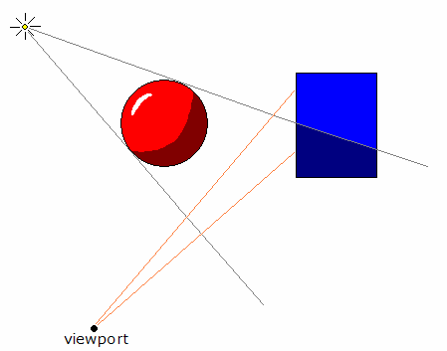
Rendering Shadows
Now what? Any ideas about how we can proceed?
light
From John Tsiombikas
camera

Slide 19
Rendering Shadows
Assume a ray originating from the eye
If it enters the shadow volume from a front face and exits from a back face, the point it reaches is not in shadow
However, if it does not exit before hitting the object, the point should be in shadow
light
camera

Slide 20
Rendering Shadows
But we are not ray tracing! How can we know if the ray enters or exits?
This is where depth and stencil buffers come in handy
Stencil buffer:
An integer buffer that stores a value for every pixel (usually an 8-bit value)
We can clear it to any value that we want (glClearStencil(int) and glClear(GL_STENCIL_BUFFER_BIT))
Has operations such as increment and decrement based on the result of the depth test (glStencilOp(sfail, dfail, dpass))
Think of stencil buffer as a counter buffer, which keeps a counter for every pixel

Slide 21
Shadow Volume Algorithm (Part I)
Clear the depth (to 1.0) and stencil buffer (to 0)
Enable depth testing and disable stencil testing
Render the scene with ambient light (note that ambient light does not produce shadows). This updates the depth buffer value for every pixel that corresponds to an object
Disable writing to the depth buffer
0 | 0 | 0 | 0 | 0 | 0 | 0 | 0
0 | 0 | 0 | 0 | 0 | 0 | 0 | 0
0 | 0 | 100 | 100 | 100 | 100 | 0 | 0
0 | 0 | 100 | 100 | 100 | 100 | 0 | 0
0 | 0 | 100 | 100 | 100 | 100 | 0 | 0
0 | 0 | 100 | 100 | 100 | 100 | 0 | 0
0 | 0 | 0 | 0 | 0 | 0 | 0 | 0
0 | 0 | 0 | 0 | 0 | 0 | 0 | 0
1.0 | 1.0 | 1.0 | 1.0 | 1.0 | 1.0 | 1.0 | 1.0
1.0 | 1.0 | 1.0 | 1.0 | 1.0 | 1.0 | 1.0 | 1.0
1.0 | 1.0 | 0.5 | 0.5 | 0.5 | 0.5 | 1.0 | 1.0
1.0 | 1.0 | 0.5 | 0.5 | 0.5 | 0.5 | 1.0 | 1.0
1.0 | 1.0 | 0.5 | 0.5 | 0.5 | 0.5 | 1.0 | 1.0
1.0 | 1.0 | 0.5 | 0.5 | 0.5 | 0.5 | 1.0 | 1.0
1.0 | 1.0 | 1.0 | 1.0 | 1.0 | 1.0 | 1.0 | 1.0
1.0 | 1.0 | 1.0 | 1.0 | 1.0 | 1.0 | 1.0 | 1.0
0 | 0 | 0 | 0 | 0 | 0 | 0 | 0
0 | 0 | 0 | 0 | 0 | 0 | 0 | 0
0 | 0 | 0 | 0 | 0 | 0 | 0 | 0
0 | 0 | 0 | 0 | 0 | 0 | 0 | 0
0 | 0 | 0 | 0 | 0 | 0 | 0 | 0
0 | 0 | 0 | 0 | 0 | 0 | 0 | 0
0 | 0 | 0 | 0 | 0 | 0 | 0 | 0
0 | 0 | 0 | 0 | 0 | 0 | 0 | 0
Color Buffer
Depth Buffer
Stencil Buffer

Slide 22
Shadow Volume Algorithm (Part II)
Draw the front faces of the shadow volume. Increment the stencil value for every pixel that passes the depth test (glStencilOp(GL_KEEP, GL_KEEP, GL_INCR))
Stencil Buffer – Front Pass
0 | 0 | 0 | 0 | 0 | 0 | 0 | 0
0 | 0 | 0 | 0 | 0 | 0 | 0 | 0
0 | 0 | 1 | 1 | 1 | 1 | 0 | 0
0 | 0 | 1 | 1 | 1 | 1 | 0 | 0
0 | 0 | 1 | 1 | 1 | 1 | 0 | 0
0 | 0 | 1 | 1 | 1 | 1 | 0 | 0
0 | 0 | 0 | 0 | 0 | 0 | 0 | 0
0 | 0 | 0 | 0 | 0 | 0 | 0 | 0
Stencil value for fragments
behind the shadow volume’s
front faces’ will be incremented

Slide 23
Shadow Volume Algorithm (Part II)
Draw the back faces of the shadow volume. Decrement the stencil value for every pixel that passes the depth test (glStencilOp(GL_KEEP, GL_KEEP, GL_DECR))
Stencil Buffer – Back Pass
0 | 0 | 0 | 0 | 0 | 0 | 0 | 0
0 | 0 | 0 | 0 | 0 | 0 | 0 | 0
0 | 0 | 0 | 0 | 0 | 0 | 0 | 0
0 | 0 | 0 | 0 | 0 | 0 | 0 | 0
0 | 0 | 1 | 1 | 1 | 1 | 0 | 0
0 | 0 | 1 | 1 | 1 | 1 | 0 | 0
0 | 0 | 0 | 0 | 0 | 0 | 0 | 0
0 | 0 | 0 | 0 | 0 | 0 | 0 | 0
Stencil value for fragments
behind the shadow volume’s
back faces’ will be decremented
Fragments outside the volume
will have zero stencil value
Fragments inside the volume
will have one stencil value

Slide 24
Shadow Volume Algorithm (Part III)
Enable stencil testing such that pixels whose stencil value is zero will be rendered
Enable writing to the depth buffer and clear it
Enable the point light source
Enable additive blending so the contribution of passing pixels will be added to the previous ambient values (glBlendFunc(GL_ONE, GL_ONE))
0 | 0 | 0 | 0 | 0 | 0 | 0 | 0
0 | 0 | 0 | 0 | 0 | 0 | 0 | 0
0 | 0 | 150 | 150 | 150 | 150 | 0 | 0
0 | 0 | 150 | 150 | 150 | 150 | 0 | 0
0 | 0 | 100 | 100 | 100 | 100 | 0 | 0
0 | 0 | 100 | 100 | 100 | 100 | 0 | 0
0 | 0 | 0 | 0 | 0 | 0 | 0 | 0
0 | 0 | 0 | 0 | 0 | 0 | 0 | 0
1.0 | 1.0 | 1.0 | 1.0 | 1.0 | 1.0 | 1.0 | 1.0
1.0 | 1.0 | 1.0 | 1.0 | 1.0 | 1.0 | 1.0 | 1.0
1.0 | 1.0 | 0.5 | 0.5 | 0.5 | 0.5 | 1.0 | 1.0
1.0 | 1.0 | 0.5 | 0.5 | 0.5 | 1.0 | 1.0 | 1.0
1.0 | 1.0 | 1.0 | 1.0 | 1.0 | 1.0 | 1.0 | 1.0
1.0 | 1.0 | 1.0 | 1.0 | 1.0 | 1.0 | 1.0 | 1.0
1.0 | 1.0 | 1.0 | 1.0 | 1.0 | 1.0 | 1.0 | 1.0
1.0 | 1.0 | 1.0 | 1.0 | 1.0 | 1.0 | 1.0 | 1.0
0 | 0 | 0 | 0 | 0 | 0 | 0 | 0
0 | 0 | 0 | 0 | 0 | 0 | 0 | 0
0 | 0 | 0 | 0 | 0 | 0 | 0 | 0
0 | 0 | 0 | 0 | 0 | 0 | 0 | 0
0 | 0 | 1 | 1 | 1 | 1 | 0 | 0
0 | 0 | 1 | 1 | 1 | 1 | 0 | 0
0 | 0 | 0 | 0 | 0 | 0 | 0 | 0
0 | 0 | 0 | 0 | 0 | 0 | 0 | 0
Color Buffer
Depth Buffer
Stencil Buffer

Slide 25
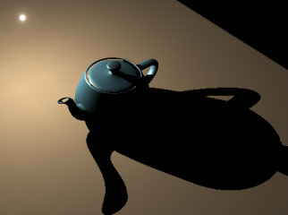
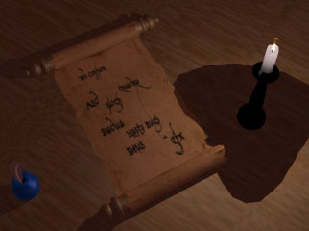
Shadow Volume Algorithm
No blending versus blending:
From John Tsiombikas

Slide 26
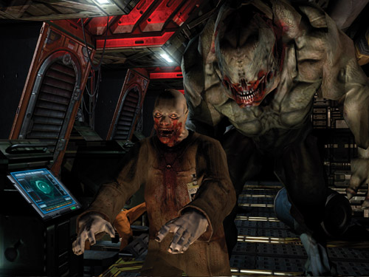
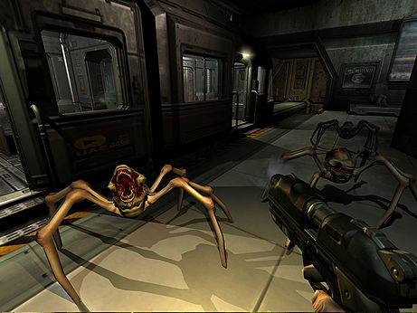
Used Applications
Doom 3 is the most well-known example (source code available at: https://github.com/id-Software/DOOM-3-BFG)
From http://http.developer.nvidia.com/GPUGems/gpugems_ch09.html

Slide 27
Pros and Cons
Requires preprocessing of the scene geometry to create the shadow volume
Needs to be updated if lights and/or objects move
Can be time consuming for complex geometry
Requires multiple rendering passes for each frame
Ambient pass
For each light:
Compute SV
SV front-face pass
SV back-face pass
Final light source pass
No need to update shadow volume if only the camera moves

Slide 28
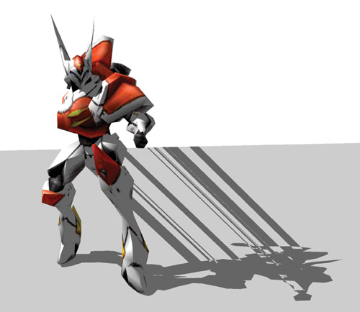
Pros and Cons
Inaccurate models can cause leaking artifacts
From http://http.developer.nvidia.com/GPUGems/gpugems_ch09.html

Slide 29
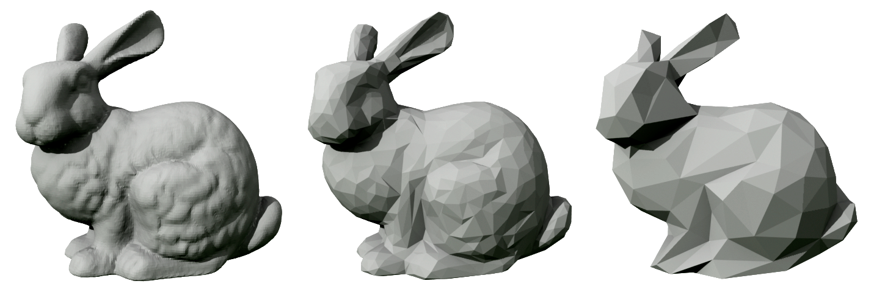
Pros and Cons
For speed-up, two versions of objects can be created:
High polygon version is used for actual rendering of the object
Low polygon version is used to cast shadows of the object
From wikipedia.com

Slide 30
Pros and Cons
The basic algorithm has variants to deal with:
Camera inside the shadow volume
Use depth-fail (Carmack’s reverse)
Increment/decrement the stencil when the shadow volume fails the depth test
Multiple light sources and multiple shadow casters
Transparent shadow casters
Further reading:
http://http.developer.nvidia.com/GPUGems/gpugems_ch09.html
http://www.angelfire.com/games5/duktroa/RealTimeShadowTutorial.htm
// Front faces
glStencilOp(GL_KEEP, GL_INCR_WRAP, GL_KEEP);
// Back faces
glStencilOp(GL_KEEP, GL_DECR_WRAP, GL_KEEP);

Slide 31
Shadow Mapping
The idea introduced by Lance Williams in his 1978 paper “Casting Curved Shadows on Curved Surfaces”
Image space technique
Advantages:
No knowledge or processing of scene geometry is required
No need to use stencil buffer
Fewer rendering passes than shadow volumes
Disadvantages:
Still requires multiple passes
Aliasing artifacts may occur (shadows may look jaggy)

Slide 32
Shadow Mapping
Part I: Render the scene from the point of view of the light source (as if the light source was a camera)
Objects that are not visible are in shadow with respect to that light source
Part II: Determine whether an object as seen from the camera is in shadow in the “light’s view”

Slide 33
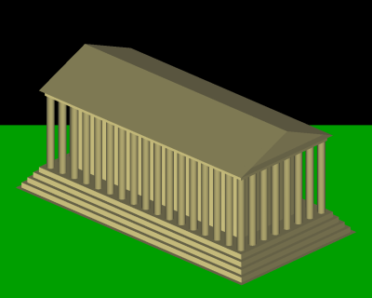
Part I: Rendering from the Light Source
Pretend that there is a camera at the light position
Use perspective projection for spot (and point) lights
Use orthographic projection for directional lights
Original camera view
Light source view

Slide 34
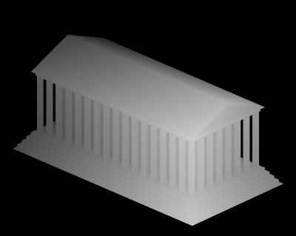
Part I: Extracting the Depth Map
Actually, we only need the depth buffer values from the light source view
Save this depth buffer to an off-screen texture (FBOs)
1 – z is shown for visualization purposes
Normally, z is larger for further away points
Depth map from the light’s view

Slide 35
Part II: Rendering from the Camera
Render the scene from the camera view as usual
For every pixel, compare the depth value of that pixel w.r.t. the light source (R) to the stored value in the depth texture (D):
But there is a problem:
Pixel (i, j) in the camera view will not belong to the same object as pixel (i, j) in the light view as they look at the scene from different positions (and with different orientations)
R = D: Object was directly visible from the light source
R > D: Object was behind another object in the light’s view

Slide 36
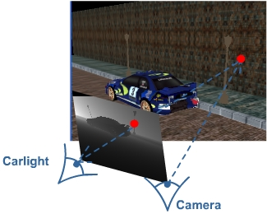
Projective Texturing
For every pixel in the camera view, we need to find the corresponding pixel in the light’s view
Transform the camera view coordinate to the light view coordinate
From http://www.riemers.net/images/Tutorials/DirectX/Csharp/Series3

Slide 37
Projective Texturing
Assume inPos represents the world coordinates of an object. Its camera coordinates are computed by:
Its light view coordinates are computed by:
We can use outPosLight to look up the depth texture we generated in Part I
But this value is in range [-1,1] in all axis (CVV)
Need to transform it to the normalized viewport coordinates
outPosCamera = cameraWorldViewProjection * inPos;
outPosLight = lightWorldViewProjection * inPos;

Slide 38
Projective Texturing - Bias
To do so we multiply it with a bias matrix to bring all components to [0, 1] range:
outPosLight = bias * lightWorldViewProjection * inPos;
Use (x, y) for depth texture lookup
Use z for z-value w.r.t.
the light (z = R)

Slide 39
Shadow Check
Remember that R is the depth value of the pixel from the light’s view and D is the stored depth in the texture:
R and D can be found by:
Now we can perform the shadow check:
R = D: Object was directly visible from the light source
R > D: Object was behind another object in the light’s view
Perspective divide
outPosLight /= outPosLight.w
R = outputPosLight.z
D = texLookUp(shadowMap, outputPosLight.xy)
if (R > (D + 0.00001))
Output.Color = Input.Color * 0.5;
else
Output.Color = Input.Color;
Darkening factor
Note that a small bias
is added to avoid self-shadowing
just like as in ray tracing

Slide 40
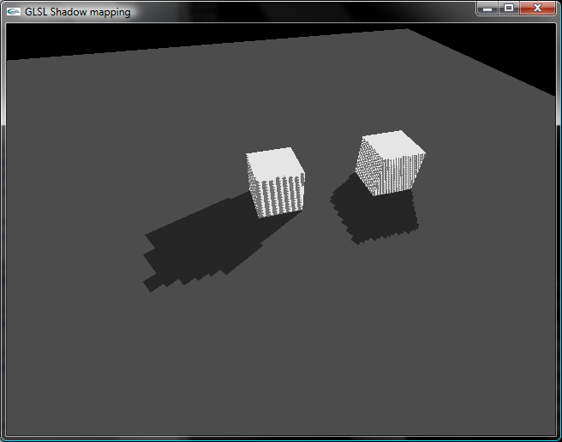
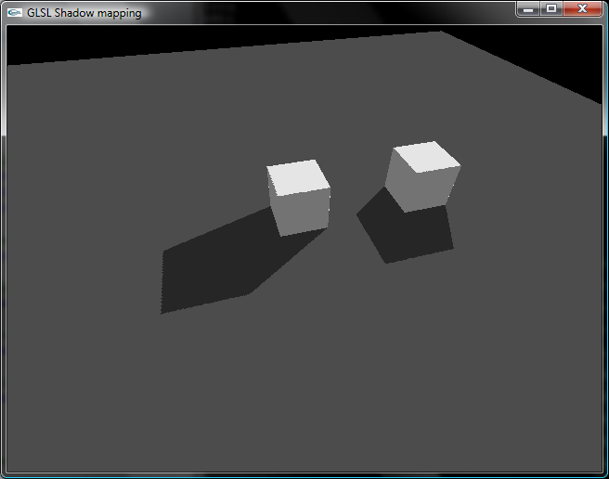
Shadow Map Resolution
If the depth texture we create in Part I does not have enough resolution, we can see blocking artifacts:
From http://bytechunk.net
160x120 shadow map
1280x960 shadow map

Slide 41
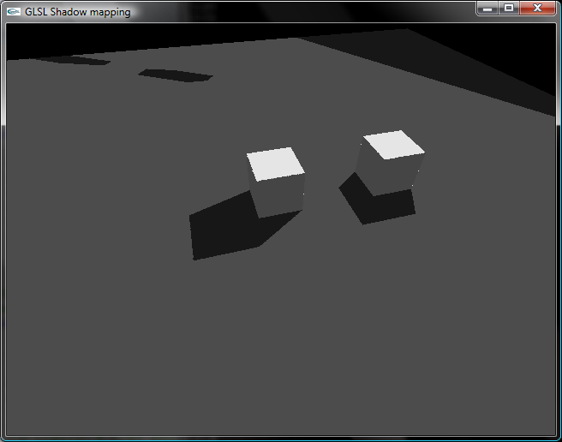
Projection Artifacts
If an object falls outside the viewing frustum of the light, we can see artifacts with a naïve implementation:
Mostly happens with directional lights
Treat as unshadowed (light reaches to the point) in this case
Shouldn’t happen for point lights if we render multiple images to contain all possible directions (like a cubemap)

Slide 42
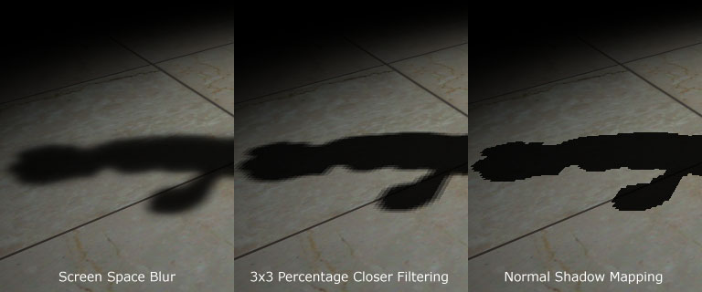
Improving the Shadow Quality
Shadow map can be filtered in various ways to create soft shadows:
From http://www.gamedev.net

Slide 43
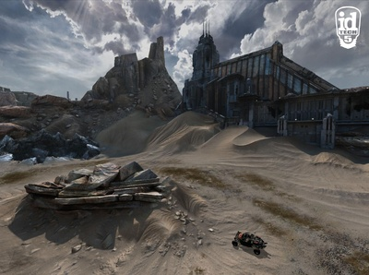
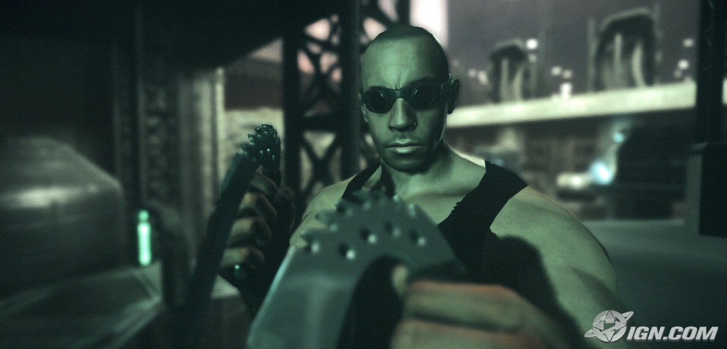
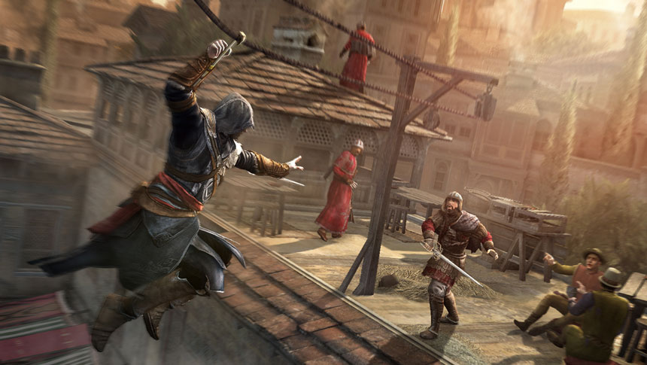
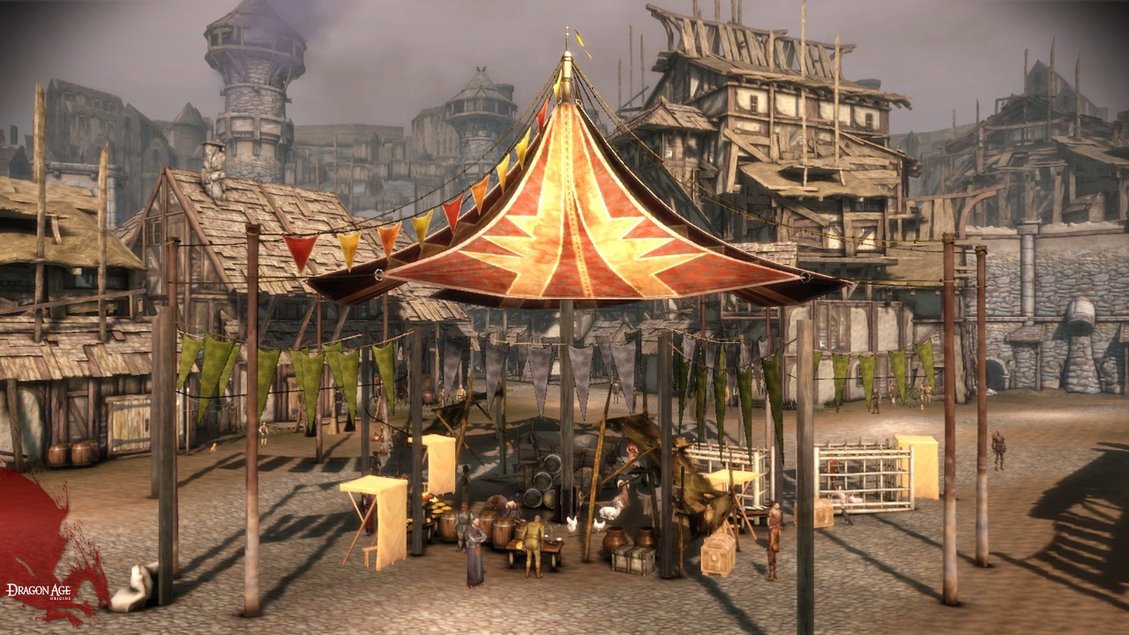
Applications Using Shadow Maps
Most games use shadow mapping. Some examples:
Riddick 2: Assault on Dark Athena
Rage
Dragon Age
Assassin’s Creed

